Slide 1




Conserving Energy as a Strategy for
Dealing with Uncertainty and Dynamics in SE
International Council on Systems Engineering
A better world through a systems approach
Rick Dove
30-July, 2025
INCOSE International Symposium 2025 | Ottawa, Canada

Slide 2
Abstract
Being agile conserves resources
in a situational engagement with
uncertainty and dynamics in pursuit of an outcome.
Uncertain knowledge and dynamic environments
present the risk of exhausting limited resources
before a valued return is achieved.
Conserving those resources
optimizes the possibility of valuable outcome achievement.
We will explore resource conservation
as systems thinking in practice and synergy in process,
and the implications of doing so.

Slide 3
Instigation
INCOSE’s 4-page Primer for
Systems Engineering Agility
outlines eight strategic aspects;
what and why – not how.
A 50-page Guide is now in development.
A deeper dive on the strategic focus (what and why),
with a variety of implementation examples (how).
The deeper dive has revealed
new questions and new points of view
being explored for possible value.

Slide 4
Context
Lifecycle Spectrum
Development
Concept
Development
Production
Utilization
Support
Retirement
Situational
Awareness
Concept
Production
certain knowledge uncertain
Static environment dynamic
Retirement
Utilization
Support
Extremely Sequential
Required Order
Plan Driven
Extremely Agile
No Order Required
Situation Driven

Slide 5



Agility
Grace,
Efficiency,
Effectiveness
of Engagement
Notes:
Engagement with the situation, not with a plan or a procedure

Slide 6
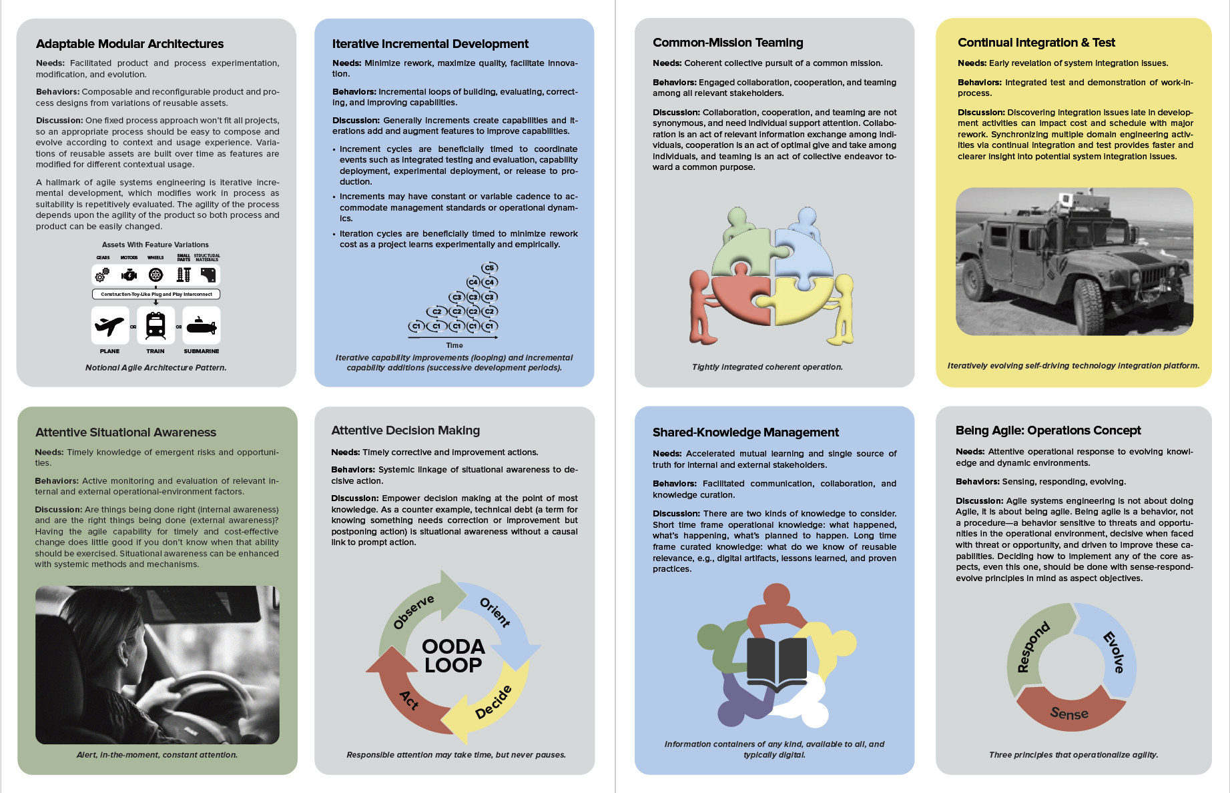
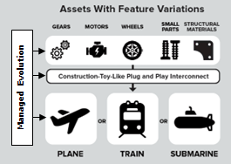
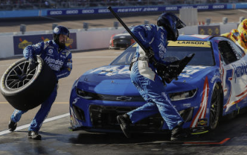

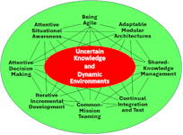
Systems Engineering Agility Primer (Just a Visual)
Composable reconfigurable constructions
Air traffic control – alert, in-the-moment, constant attention
Attentive decisions change wrong tires that would take toll every lap
Agility emerges from synergistic relationships among aspects.

Slide 7
Adaptable Modular Architectures
Behavior Lens:
Composable and reconfigurable designs
from evolving variations of reusable assets
Conservation Lens:
Streamlines systems composition with
reusable and modifiable parts
Composable reconfigurable constructions

Slide 8
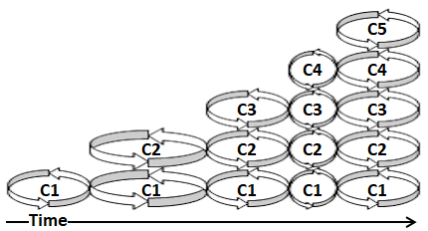
Iterative Incremental Development
Behavior Lens:
Incremental loops of
building, evaluating, correcting, and improving capabilities
Conservation Lens:
Minimizes rework, maximizes quality, facilitates innovation
Iterative capability improvements and incremental capability additions

Slide 9
Attentive Situational Awareness
Behavior Lens:
Active monitoring and evaluation of
relevant internal and external environment factors
Conservation Lens:
Reveals problems/opportunities that would consume more time and cost later
Air traffic control –
alert, in-the-moment, constant attention

Slide 10
Attentive Decision Making
Behavior Lens:
Systemic linkage of situational awareness
to decisive action
Conservation Lens:
Optimizes decision timing
to minimize no-return expendatures
Attentive decisions change wrong tires
that would take toll every lap

Slide 11
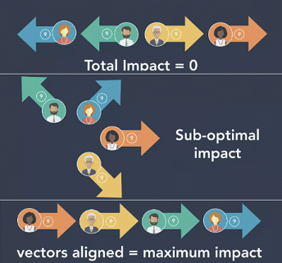
Common-Mission Teaming
Behavior Lens:
Engaged collaboration, cooperation, and teaming
among all relevant stakeholders
Conservation Lens:
Minimizes counter productive effort
by aligning teamwork
Team alignment determines total impact
(art: D. Shah, 2020)

Slide 12

Shared-Knowledge Management
Behavior Lens:
Facilitated communication, collaboration, and
knowledge curation
Conservation Lens:
Minimizes incompatible effort and
facilitates implementation synergy
Emraceable information containers of any kind,
available to all, and typically digital

Slide 13
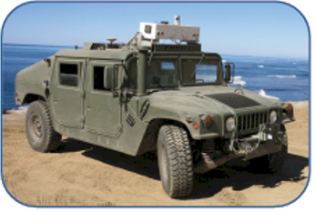
Continual Integration & Test
Behavior Lens:
Integrated test and demonstration
of work-in-process
Conservation Lens:
Minimizes cost and effort to
mitigate integration issues
An iteratively evolving, self-driving technology,
integration platform used at US Navy project

Slide 14
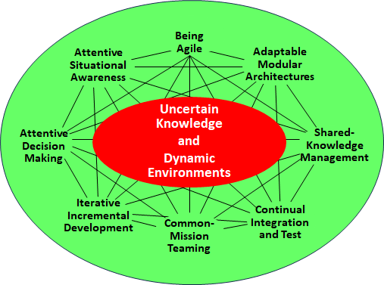
Being Agile
Behavior Lens:
Sense-respond-evolve engagement
with a dynamic environment
Conservation Lens:
Grace, efficiency, and effectiveness of
situation-driven engagement
Agility emerges from sense-respond-evolve synergy among Aspects

Slide 15
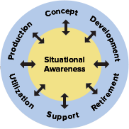
On Emergence
Group Experiential Engineering at Tesla
The driving mission is innovation.
Agility is an emergent characteristic.
Full-Stack Teams
Plan-Build-Test-Deploy
Full-Stack Teams
Plan-Build-Test-Deploy
SMEs
IS25 Paper
Innovation Engineering at Tesla –
Agility as a Cultural Practice
D
o
R
Builder
Tools
Advisors
D
o
D
D
o
R
D
o
D
Digi
Asst.
Hands-on engineering
with rotating
builder/advisor roles
Capability Innovation
Evolution
Build a little, test a little, learn a lot
(Rear Admiral Wayne E. Meyer, USN)
Aspects are not overtly discernable as separable strategies,
but appear as a merged, overlapping, simultaneous way of working,
a holistic cultural behavior.

Slide 16
On Synergy harmonious, cohesive, coherent
Chords of music are pleasing and comfortable
because of how the parts complement each other,
whereas discordant sounds
don’t feel harmonious, cohesive, coherent.
Agility (e.g., in dance and sword fighting) manifests as
grace, efficiency, and effectiveness
of engagement.

Slide 17
Agility is an Emergent Behavior of
Synergistic Aspect Relationships
Being
Agile
Being
Agile
Attentive
Situational
Awareness
Adaptable
Modular
Architectures
Attentive
Situational
Awareness
Adaptable
Modular
Architectures
Uncertain
Knowledge
and
Dynamic
Environments
Uncertain
Knowledge
and
Dynamic
Environments
Attentive
Decision
Making
Shared-
Knowledge
Management
Attentive
Decision
Making
Shared-
Knowledge
Management
Iterative
Incremental
Development
Continual
Integration
and Test
Iterative
Incremental
Development
Continual
Integration
and Test
Common-
Mission
Teaming
Common-
Mission
Teaming
Reductionist (Structural) View
Characterizes an aspect’s nature in isolation
independent of its relationships.
Holistic (Behavioral) View
A network of synergistic aspect relationships
that manifest as holistic systemic behavior.

Slide 18
Bifocal Lens
Aspect
Adaptable Modular Architectures
Iterative Incremental Development
Attentive Situational Awareness
Attentive Decision
Making
Common-Mission
Teaming
Shared-Knowledge
Management
Continual Integration &
Test
Being Agile
Behavior Lens
Composable and reconfigurable designs from evolving variations of reusable assets
Incremental loops of building, evaluating, correcting, and improving capabilities
Active monitoring and evaluation of relevant internal and external environment factors
Systemic linkage of situational awareness to decisive action
Engaged collaboration, cooperation, and teaming among all relevant stakeholders
Facilitated communication, collaboration, and knowledge curation
Integrated test and demonstration of work-in-process
Sense-respond-evolve engagement
with a dynamic environment
Conservation Lens
Streamlines systems composition with reusable and modifiable parts
Minimizes rework, maximizes quality, facilitates innovation
Reveals problems/opportunities that would consume more time and cost later
Optimizes decision timing to minimize
no-return expenditures
Minimizes counter productive effort by aligning teamwork
Minimizes incompatible effort and
facilitates implementation synergy
Minimizes cost and effort to
mitigate integration issues
Grace, efficiency, and effectiveness of situation-driven engagement

Slide 19
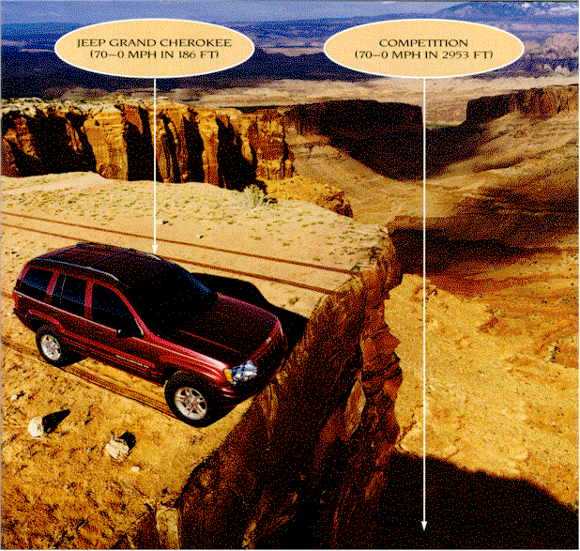
Inertia – The Bane of Agility

Slide 20
Implications
Grace, efficiency, effectiveness.
Conservation of resources
is an operating objective & metric of being agile.
A metric to evaluate and improve strategic aspects independently.
A metric to evaluate and improve synergy & balance among Aspects.
Not an end – a means.

